Slide 1

Big-Oh: Relatives (Omega & Theta)
Asymptotic Analysis
Design and Analysis of Algorithms I

Slide 2
Omega Notation

Slide 3
Theta Notation

Slide 4
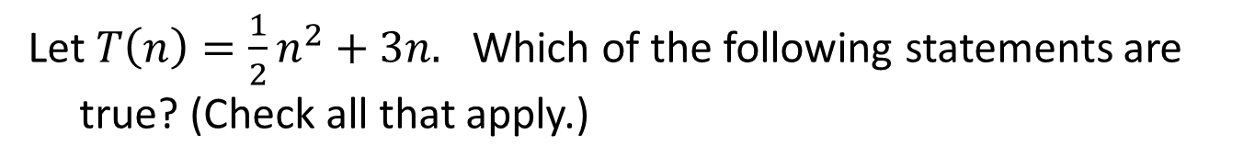
Let $T\left(n\right)=\frac{1}{2}n^{2}+3n.$ Which of the following statements are true? (Check all that apply.)
$$T\left(n\right)=O\left(n\right).$$
$$T\left(n\right)=Ω\left(n\right).$$
$$T\left(n\right)=Θ(n^{2}).$$
$$T\left(n\right)=O(n^{3}).$$

Slide 5
Little-Oh Notation

Slide 6
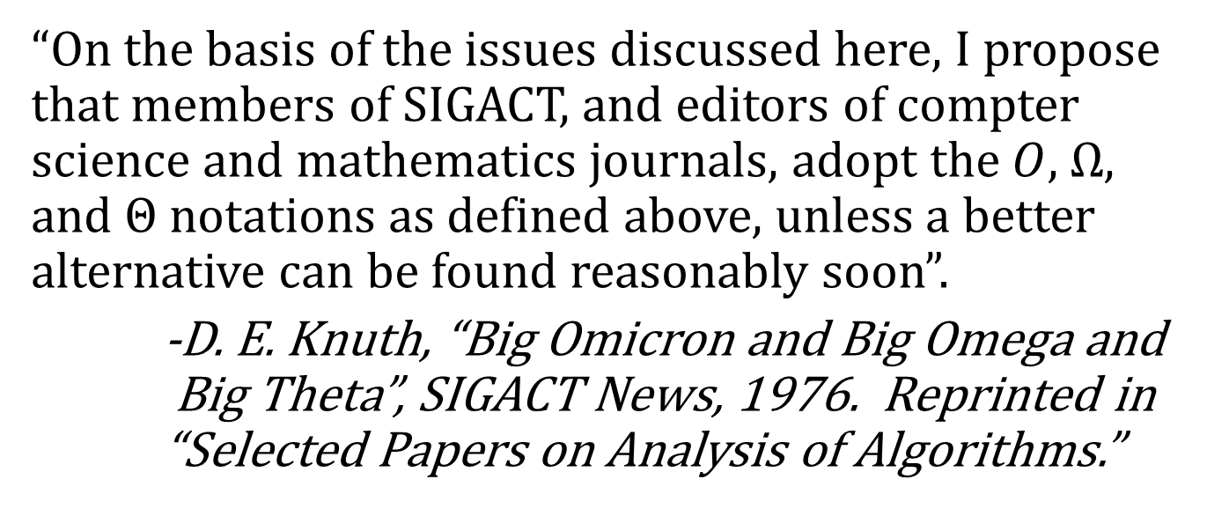
Where Does Notation Come From?
“On the basis of the issues discussed here, I propose that members of SIGACT, and editors of compter science and mathematics journals, adopt the $O,$ $Ω,$ and $Θ$notations as defined above, unless a better alternative can be found reasonably soon”.
-D. E. Knuth, “Big Omicron and Big Omega and Big Theta”, SIGACT News, 1976. Reprinted in “Selected Papers on Analysis of Algorithms.”

